Slide 1
COMPARITIVE STUDY ON REGRESSION TECHNIQUES
BY-
PRIYADHARSHINI M
(1813422046009)

Slide 2
O v e r v i e w
Literature review
Objective
Introduction
Research Methodology
Data Description
Result
Interpretation

Slide 3
REVIEW TOPIC WITH AUTHOUR | EXPLANATION
COMPARING LINEAR, RIDGE AND LASSO REGRESSION TECHNIQUES USING WINE DATA- Mayooran Thevaraja, Azizur Rahman, Mathew Gabirial. | In this paper only white wine data has been chosen for the analysis. Calculating the RSS values on the test data set provides a good way to assess the regression model. It has been given that Ridge and Lasso gives less RSS values, which means that Ridge and Lasso are the best fitting models.
“THE LOGISTIC LASSO AND RIDGE REGRESSION IN PREDICTING CORPORATE FAILURE”- Jose Manuel Pereira, Mario Bastoa, Amelia Ferreira da Silvab , Rua Dr. Roberto Frias. | The model contained with 2032 non-bankrupt firms and 401 bankrupt firms, over the period 2010-2012. The results showed that the lasso and ridge models tend to favor the category of the dependent variable that appears with heavier weight in the training set, when compared to the stepwise methods.
A SURVEY ON REGRESSION ESTIMATE WITH LASSO METHOD - Ms. Anjali, Mr. Rakesh Shivhare, Ms. Komal Pandey, Mr. Mukesh Dixit. | Several quantitative methods have been working to develop observed models for predicting commercial bankruptcy. . They fit Lasso but they compare both ridge and lasso to analyse the data in a more detailed format.
“Feature Selection using LASSO” by Valeria Fonti. | Introduction of feature selection task, the LASSO method, and applies the LASSO feature selection property to a Linear Regression problem, and the results of the analysis. And fnally, the same analysis is repeated on a Generalized Linear Model in particular with a Logistic Regression Model
“Ridge and Lasso Regression Models for Cross-Version Defect Prediction” - Xiaoxing Yang , Wushao Wen . | Sorting software modules in order of defect count can help testers to focus on software modules with more defects. It has been shown that Ridge regression has comparable performance and less model construction time compared to LASSO regression.

Slide 4
Objective
To find out a better regression technique that gives almost accurate prediction.

Slide 5
Research Methodology
Secondary data was collected.
Jupyter Notebook, SPSS is used for the analysis process.
Pandas, numpy, Sklearn, are the packages used.
Accuracy and coefficients of the variables were found.
Comparison of coefficients between all three regression techniques and checking accuracy.

Slide 6
Discussions of major 3 types of regression
Linear regression
Ridge regression
LASSO regression

Slide 7
LINEAR REGRESSION
Attempts to model the relationship between two variables.
A linear regression line has an equation of the form,
𝑌 = 𝑋𝛽 + 𝜀,
X is considered to be an independent variable (explanatory variable) and Y is considered to be a dependent variable (criterion variable).
As we don't know the true parameters 𝛽, we have to estimate them from the sample.
The most common method for fitting a regression line is the method of least-squares.
For example, a modeler might want to relate the weights of individuals to their heights using a linear regression model.

Slide 8
Advantage and Disadvantage of Linear regression
Advantages
Disadvantages
The modeling speed is fast even when the data is large does not require very complicated calculations.
Linear Regression is easier to implement, interpret and very efficient to train.
The understanding and interpretation of each variable can be given according to the coefficient
Main limitation of Linear Regression is the assumption of linearity between the variables.
Prone to noise and overfitting.
Prone to outliers.
Prone to multicollinearity.

Slide 9

RIDGE REGRESSION
Ridge Regression is a technique for analyzing regression data that suffer from multicollinearity.
When multicollinearity occurs, least squares estimates are unbiased, but their variances are large so they may be far from the true value.
By adding a degree of bias to the regression estimates, ridge regression reduces the standard errors.
Similar to LSE, Ridge Regression coefﬁcients are estimated by minimizing the loss function,
Here λ is the turning factor that controls the strength of the penalty term.

Slide 10

LASSO REGRESSION
LASSO (Least Absolute Shrinkage Selection Operator).
Lasso regression is a type of linear regression that uses shrinkage. Shrinkage is where data values are shrunk towards a central point.
The lasso procedure encourages simple, sparse models (i.e. models with fewer parameters).
This particular type of regression is well-suited for models showing high levels of multicollinearity or when you want to automate certain parts of model selection, like variable selection/parameter elimination.
Lasso Regression adds “absolute value of magnitude” of coefficient as penalty term to the loss function.

Slide 11
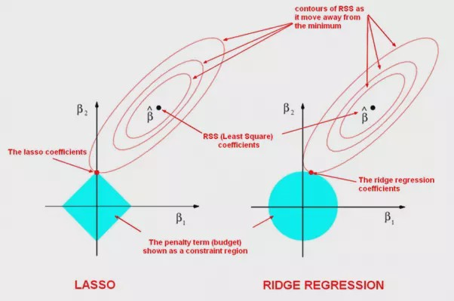
Comparison of ridge and LASSO

Slide 12
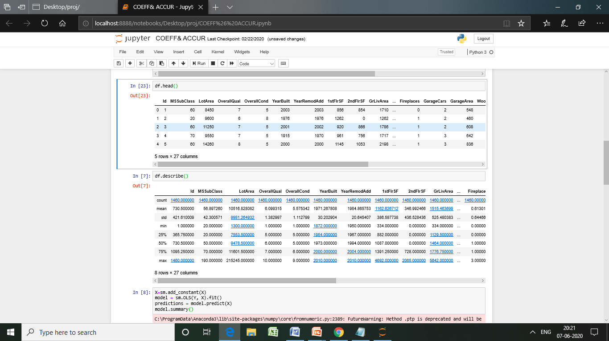
I’ve taken zillow’s house pricing data with 26 variables. From which SalePrice is the dependent variable we are going to predict and other 25 are the independent variables.
Data description
RESULT-

Slide 13
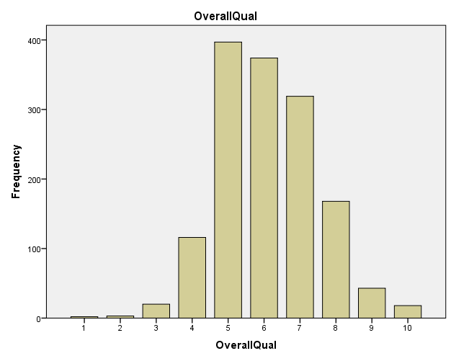
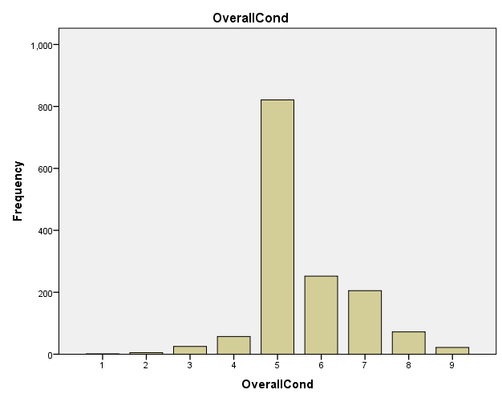
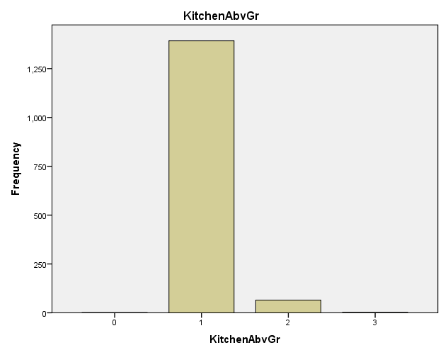
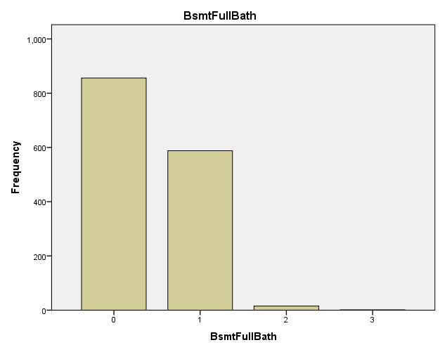
RESULT- BAR GRAPH

Slide 14
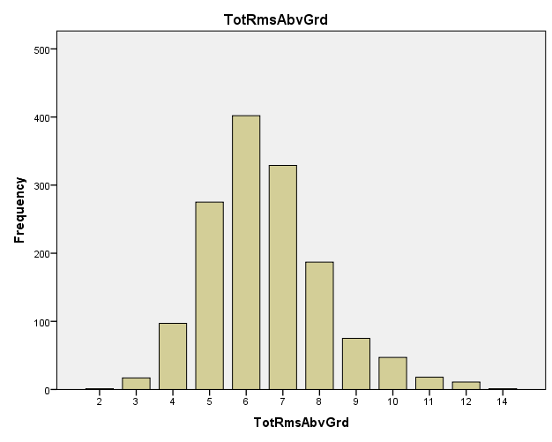
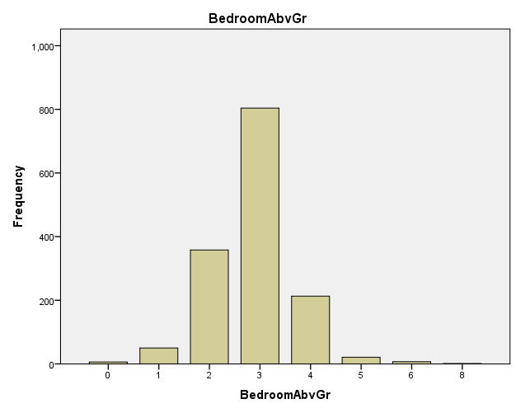
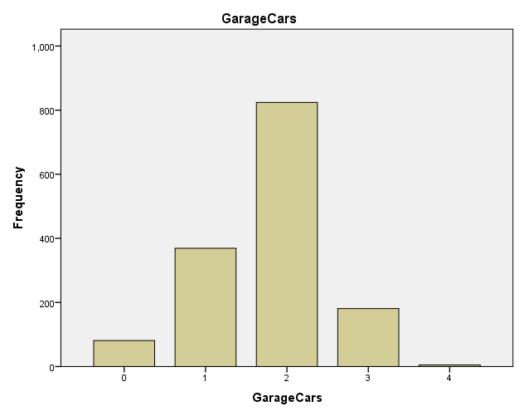
Here, I have visualized some of the variables that give more impact to prediction.

Slide 15
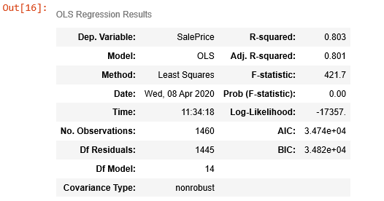
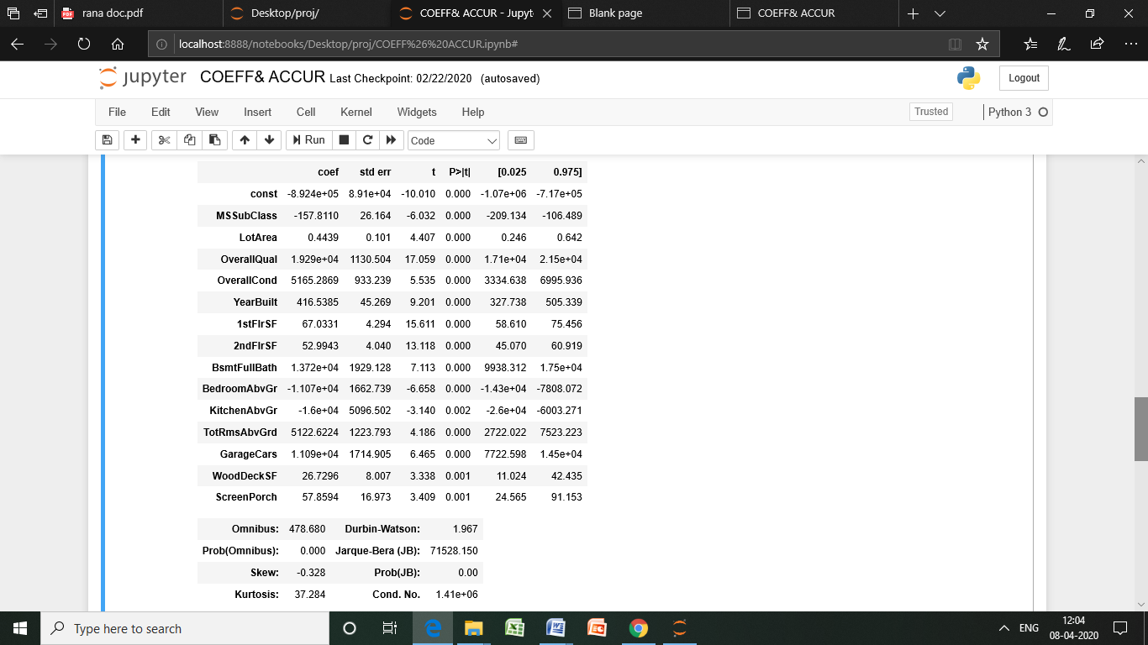
Result:
OLS estimate

Slide 16
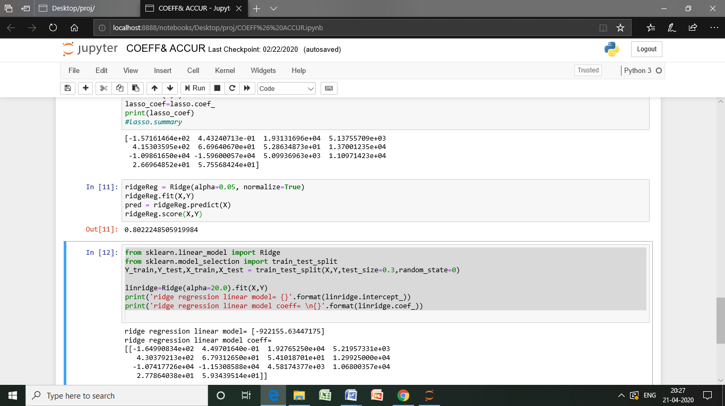
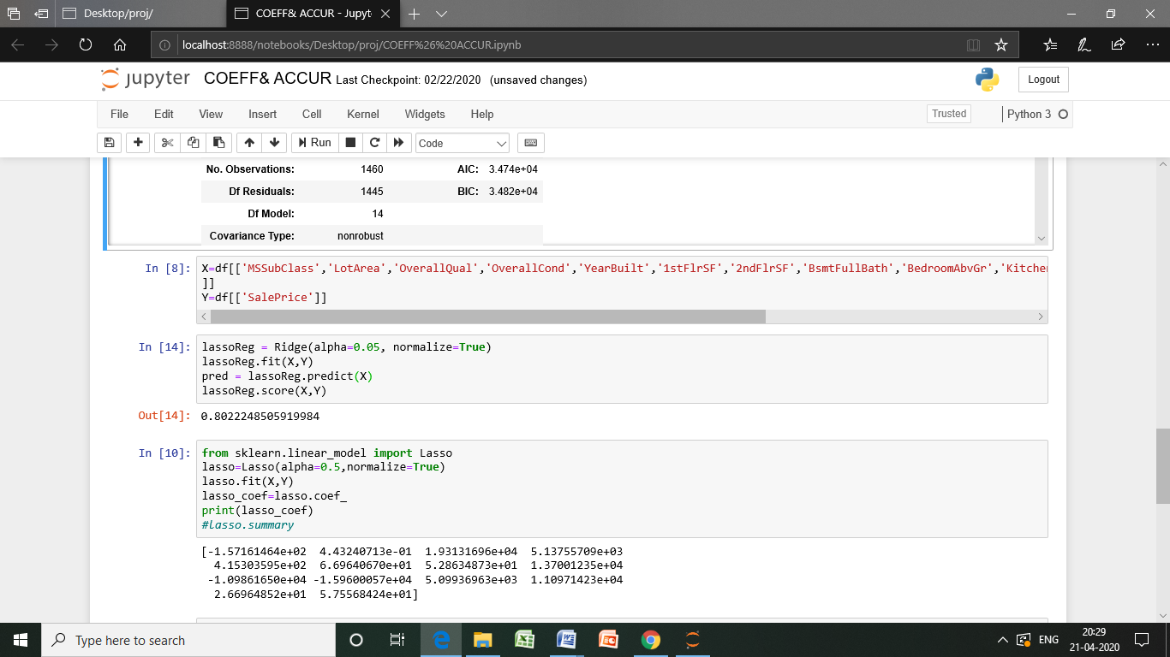
Ridge regression
Comparisons:
ACCURACY CHECKING
LASSO REGRESSION
We get same amount of accuracy in both regression. But, we get 80.2%
level of accuracy, bit greater than that of linear regression. With this comparison I could say advanced regression would give better prediction than that of linear regression.

Slide 17
RESULT-
VARIABLES | COEFFICIENTS
 | Linear regression | Ridge | Lasso
Const | -892400.00 | 0.00 | 0.00
MSSubClass | -157.81 | -164.99 | -157.16
LotArea | 0.44 | 0.45 | 0.44
OverallQual | 19290.00 | 19276.53 | 19313.17
OverallCond | 5165.29 | 5219.57 | 5137.56
YearBuilt | 416.54 | 430.38 | 415.30
1stFlrSF | 67.03 | 67.93 | 66.96
2ndFlrSF | 52.99 | 54.10 | 52.86
BsmtFullBath | 13720.00 | 12992.50 | 13700.12
BedroomAbvGr | -11070.00 | -10741.77 | -10986.17
KitchenAbvGr | -16000.00 | -11530.86 | -15960.01
TotRmsAbvGrd | 5122.62 | 4581.74 | 5099.37
GarageCars | 11090.00 | 10680.04 | 11097.14
WoodDeckSF | 26.73 | 27.79 | 26.70
ScreenPorch | 57.86 | 59.34 | 57.56

Slide 18
Interpretation
Regression techniques are used to predict and for better prediction we use Ridge and LASSO regression.
While comparing the coefficients of all there regression techniques from which I could see the shrinkage of coefficients which shrunk towards zero and it is very transparent that Ridge and LASSO regression perform a way better than Linear regression.
When I compare Ridge and Lasso regression technique I prefer LASSO regression to use for prediction of Zillow’s home value data since variable shrinkage can been seen better compared to Ridge regression.

Slide 19
BIBLIOGRAPHY
Beginning Programming with Python For Dummies (For Dummies Series) by John Paul Mueller.
Introduction to the analysis of learning algorithms: ridge regression and lasso by Ryota Tomioka.
Python Data Analytics: Data Analysis and Science Using Pandas, matplotlib, and the Python Programming Language by Fabio Nelli.
“Linear, Ridge and Lasso Regression comprehensive guide for beginners”- https://www.analyticsvidhya.com/blog/2017/06/a-comprehensive-guide-for-linear-ridge-and-lasso-regression/.
Python Programming. Python Programming for Beginners, Python Programming for Intermediates by Adam Stewart.
“Visual Explanation of Ridge Regression and LASSO”- https://www.slideshare.net/kaz_yos/visual-explanation-of-ridge-regression-and-lasso.
Ridge/Lasso Regression, Model selection by Xuezhi Wang.

Slide 20
THANK YOU ☺
Under the guidance of
Mrs. JANANI B, M.Sc., M.Phil.,

